Slide 1

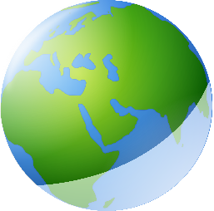




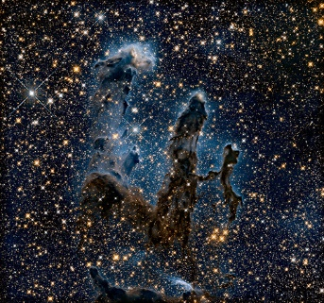




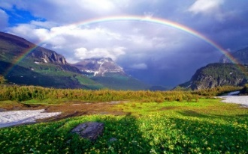



RE – Reception– What makes our world wonderful?
A wonderful world:
Our world is a place of wonder, and some people believe it was created by God. Many people look at the world around them and see amazing things that fill them with awe and wonder—like the bright colors of a rainbow or the way birds can fly. Some people believe that these wonders didn’t just happen by chance but were created by God. They believe that God made the sun, the moon, the stars, the animals, and everything that lives on the Earth, from the tiniest insect to the tallest mountain.
Key Vocabulary
alive | adjective. living and not dead.
Amazing | adjective. very surprising or wonderful.
Bible | noun. a special book for Christians that tells stories about God and Jesus.
creation | noun. making something new. Some people believe God created the world.
God | noun. the creator and ruler of the universe, worshipped by many people.
look after | verb phrase. to take care of something or someone.
special | adjective. something that is important or different in a good way.
story | noun. a tale about events, real or imagined.
unique | adjective. one of a kind, unlike anything else.
wonder | noun. something that makes you feel surprise and amazement.
world | noun. the Earth and all the people, animals, and places on the Earth.
The story of Creation in the Bible
The Bible has a story that tells how God created the world in seven days. On the first day, God made light and darkness, separating day from night. On the second day, He made the sky. On the third, He made land, sea, and plants. He filled the sky with the sun, moon, and stars on the fourth day. On the fifth day, He created birds and sea animals. Then, on the sixth day, He made all the animals that live on the land, and finally, He made humans to take care of His creation. On the seventh day, God rested. This means Christians believe that God created everything in the world, from the big oceans to the tiny ants. They believe that God made everything for a reason, and that every part of nature is important. For example, God may have created trees to give us fresh air and food, and He created animals to fill the earth with life and beauty. This means everything is connected and fits together like a big puzzle.
How you ever made something you were proud of?
Have you ever built something out of Lego, painted a picture, or baked a cake? How did it feel when you finished it? When we make something, we often feel proud because we worked hard and created something special. In the same way, some people believe God is proud of the world He created because it is beautiful and full of life.
What makes the world wonderful?
There are so many things in the world that are wonderful! Think about the soft fur of a newborn kitten, the smell of fresh flowers, or the taste of a juicy apple. Take a walk outside and look for things that make you feel happy and amazed. Is it the tall trees? The bright blue sky? Or maybe the way the leaves change colour in the autumn? The ways the birds sing in the morning? These are all examples of the wonders of the world. Drawing or talking about these things can help us appreciate the wonders all around us.

