Slide 1

RE – Y6 – Christianity – What do Christians believe about creation?
Human’s role in Creation:
God’s Gift: Christians believe that the world is a gift from God. In the Bible, after creating everything, God saw that it was "very good" (Genesis 1:31). He gave humans the responsibility to rule over (or have "dominion" over) all living things—animals, plants, and the Earth itself (Genesis 1:28). This doesn't mean humans can do whatever they want; it means they are responsible for taking care of the world. Stewardship: The idea of stewardship means that humans are the caretakers of God’s creation. God made everything perfect and beautiful, and it’s humanity’s job to protect it and use it wisely. Christians believe they must treat the Earth kindly, look after the environment, and respect animals and other people, because the Earth belongs to God. Made in God’s Image: In Genesis, it says that humans were made in the image of God (Genesis 1:27). This gives humans a special place in creation. It means they are meant to reflect God’s goodness and love in the way they care for the world and each other.
Key Vocabulary
The fall | noun. When Adam and Eve disobeyed God, all creation was affected by their choice and they fell away from the perfect relation with God.
free will | noun. being able to make one’s own choice.
genesis | noun. the origin or mode of formation of something. A book in the Bible.
humanity | noun. human beings collectively.
responsibility | noun. the state or fact of having a duty to deal with something or of having control over someone.
suffering | noun. the state of undergoing pain, distress, or hardship.
What creation means for Christians’ relationship with God:
Connection to God: For Christians, creation is a way of feeling closer to God. They see the beauty of the world—like the mountains, oceans, animals, and stars—as signs of God’s power, love, and creativity. Being thankful for creation helps Christians build a stronger relationship with God, because they believe He is the source of all life. Responsibility and Worship: Caring for the environment and respecting creation is also a way of worshipping God. By looking after the world, Christians are showing their love and gratitude to God. They believe that everything belongs to God, so taking care of it is an act of respect and worship. Hope for the Future: Christians also believe that God has a plan for creation. They trust that by caring for the Earth, they are part of God’s bigger plan to make everything perfect and whole again in the future.
God’s promise to make “all things new” and end all suffering
In Christianity, there’s a promise that one day, God will make "all things new" and put an end to all pain, sadness, and suffering following Adam and Eve’s choice. Jesus’ Role: Christians believe that when Jesus came to Earth, He started God’s plan to fix everything. Jesus came to show people how much God loves them and to take away their sins by dying on the cross and coming back to life. A New Heaven and a New Earth: The Bible says that one day, God will create a new heaven and a new Earth (Revelation 21:1-4). In this new world, there will be no more suffering, pain, or death. It will be a place of perfect peace, and everything will be good again. No More Tears: One of the most beautiful promises is that in this new world, “God will wipe away every tear” (Revelation 21:4). This means there will be no more crying, no more sadness, and no more bad things happening. Why This Gives Hope: Christians find hope in this promise because they believe that no matter what hard things they face now, they can look forward to a future where God will fix everything and make it perfect again. They believe God will bring about a new beginning for everyone who trusts in Him.
Free Will and the Fall of Creation:
In Christianity, humans are given something very special called free will, which means they can make their own choices. God wanted people to love Him freely, not because they were forced to. But with free will comes responsibility. People can make good choices or bad choices. Free Will and the Fall of Creation: Adam and Eve’s Choice: According to the Bible, when God created the first humans, Adam and Eve, He gave them everything they needed in the Garden of Eden. He told them they could eat from any tree except the Tree of the Knowledge of Good and Evil. This was a test of their free will. The Wrong Choice: Unfortunately, Adam and Eve made the wrong choice. They were tempted by a serpent (representing evil) and chose to eat the fruit from the forbidden tree. This disobedience is called "The Fall", because it caused them to fall away from the perfect relationship they had with God. The Consequences: Because Adam and Eve disobeyed God, sin entered the world. This means that humans became separated from God, and as a result, all of creation was affected. There was no more perfect peace; now there was suffering, pain, and death. This fall brought harm to the Earth and all living things. In summary, Christians believe that free will is a gift from God, but because Adam and Eve made the wrong choice, it led to the fall of creation, introducing sin and suffering into the world.

Slide 2
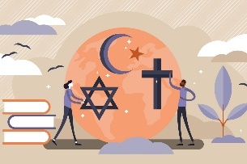
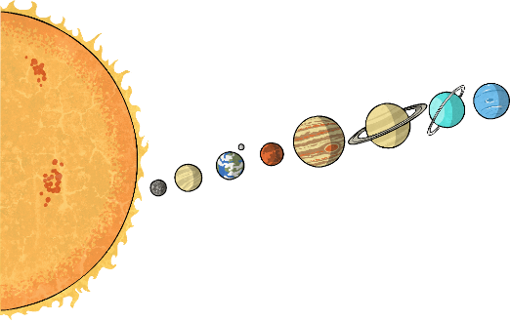
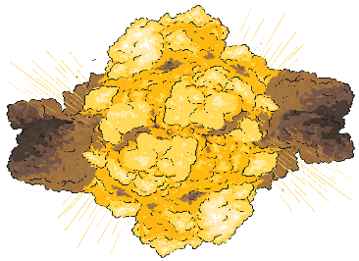
RE – Y6 – Christianity – What do Christians believe about creation?
Abrahamic religions
The term "Abrahamic religions" refers to the monotheistic, or worshipping one God, religions of Judaism, Christianity, and Islam. These religions are so named for their connection to the prophet Abraham.
Different interpretations of the Creation Story
Some Christians believe in the creation story 'literally' which means they believe exactly what was written in The Bible. Other Christians believe that the writers of the Bible were inspired by God’s actions. They interpret Genesis 1 as fact but believe each day was actually an era that lasted millions or billions of years. Some Christians interpret the Bible metaphorically. These Christians will accept scientific theories about the origins of the universe, such as the Big Bang theory. What is important for these Christians, is the message of the Genesis account of creation, which is that God created the world, and gave humans a special role, status and purpose in it.
The Big Bang Theory
The universe is defined (by the European Space Agency) as “…everything we can touch, feel, sense, measure or detect. It includes living things, planets, stars, galaxies, dust clouds, light, and even time. Before the birth of the Universe, time, space and matter did not exist.” The Big Bang Theory is the idea of how the universe started. A long, long time ago (about 13.8 billion years ago!), the whole universe was just a tiny, incredibly hot and dense point, smaller than a grain of sand. Then, suddenly, it exploded! This explosion is called the Big Bang. After the Big Bang, the universe started to expand, getting bigger and cooler. Over time, the first stars and galaxies formed. As the universe kept growing, more planets, stars, and everything we see in space today came into being. So, the Big Bang was the start of everything – all the stars, planets, and even life! The Big Bang Theory is widely accepted by the scientific community. One big piece of evidence to support the Big Bang Theory is that galaxies and stars are now moving further away from us. This supports the idea that the universe was once trapped inside a tiny bubble.
The Creation Story in Abrahamic religions
The creation narrative is shared by Jews, Christians and Muslims. In all these stories, God is the creator and humans are special, created by Him.
Christianity (Bible - Book of Genesis): In the beginning, God created the world in 6 days. Day 1: Light and darkness (day and night). Day 2: Sky and sea. Day 3: Land, plants, and trees. Day 4: Sun, moon, and stars. Day 5: Fish and birds. Day 6: Animals and the first humans, Adam and Eve. Day 7: God rested. | Judaism (Torah - Book of Genesis): The creation story in Judaism is exactly the same as the Christian story because the Torah's Book of Genesis is shared with the Christian Bible. God also created the world in 6 days, starting with light and ending with humans, Adam and Eve. |  | Islam (Qur'an): In Islam, God (Allah) also created the universe and everything in it. The Qur'an doesn’t say the world was made in exactly 6 days, but it does say Allah created everything in stages. Humans, like in Christianity and Judaism, were created by Allah, starting with the first man, Adam.
Similarities: All three religions believe in one God who created the world and humans. All three believe that the first human was Adam. They all agree that God created everything in stages, including the Earth, plants, animals, and humans. |  | Differences: Timeframe: Christianity and Judaism say creation took 6 days. In Islam, there’s no specific day count, just stages. Details: The specific details in how things were created differ. For example, in Islam, the story doesn’t focus on the order of creation in the same way as the Bible and Torah. Resting: In Christianity and Judaism, God rests on, but in Islam, Allah does not rest, as He is always active.

