Slide 1

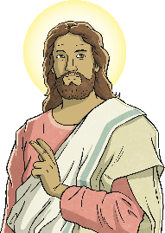

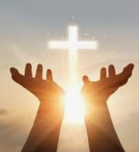
RE – Y4 – Christianity – How did Jesus change lives and why is it good news?
Jesus, the Son of God
Throughout his time on Earth, Jesus performed many amazing miracles and helped many people. Part of the reason why he did so many amazing things is because he wanted Christians to be sure he really was the Son of God.
Jesus changed lots of people’s lives through his miracles. Who has changed your life and why?
How does influence work?
Influence is when someone or something helps to shape the way we think, feel, or act. For example, if you see a friend being kind to others, that might make you want to be kind, too. Influence can come from many places—our family, friends, teachers, or even things we see on TV or read in books. It's important to think about who or what is influencing us and if it's helping us make good choices. Good influences encourage us to be kind, helpful, and honest, while bad influences might push us to do things that aren’t right. So, it's important to choose positive influences in our lives!
Key Vocabulary
disciples | noun. a person who accepts and helps to spread the teachings of another. For Christians, this means being a follower of Jesus Christ.
encounter | verb. unexpectedly be faced with or experience (something hostile or difficult).
follower | noun. a person who supports and admires a particular person or set of ideas.
influence | verb. to affect or change someone or something in an indirect but usually important way.
impact | noun. the strong effect on someone or something.
miracle | noun. an event that cannot be explained by the laws of nature or science.
outcast | noun. a person who has been rejected or ostracized by their society or social group.
people with leprosy | noun. an infectious disease that damages a person's nerves and skin
Son of God | noun. refers to the status of Jesus as the divine son of God the Father
saviour | noun. a person who saves someone or something from danger or difficulty. noun. in Christianity, God or Jesus Christ as the redeemer of sin and saver of souls.
Friends of Jesus
Jesus was kind and made friends with people who were often ignored or disliked by others. He spent time with ordinary people, like fishermen, and also with those who were considered "outcasts," like tax collectors, lepers (people with skin diseases), and women, who were sometimes treated unfairly. Jesus showed that everyone is important and loved by God, no matter who they are or what others think of them. Christians believe that Jesus’ actions teach them to be kind, loving, and caring to others, no matter who they are.
Finding meaning in Jesus’s miracles today:
Christians may find meaning today in the miracles of Jesus in a number of ways: • They show that Jesus is fully God and has divine power. • They show the nature of God as a compassionate and forgiving father, ready to help the poorest and sickest in society. This gives many Christians a good example to follow. • They show Christians that the way to God is through Jesus and through having faith in him.
How were the miracles good news?
Miracles are good news because they remind Christians that God loves everyone and that they should try to follow Jesus’ example by helping and caring for others. His miracles show that God is powerful and wants to help people, and His encounters with different people show that no one is too small or unimportant for God’s love. They gives Christians hope, knowing that they can trust in God and make a difference in the world by being kind and loving like Jesus.
How do non-religious people celebrate new life ?
Non-religious people, such as Humanists, also celebrate new life in special ways. For example, when a baby is born, they might have a naming ceremony. This is a happy occasion where family and friends come together to celebrate the new baby. Instead of focusing on religious beliefs, they celebrate the child’s life, the love in the family, and the hopes they have for the baby’s future. People might make promises to help care for and support the child as they grow. It's all about love, family, and community.

Slide 2

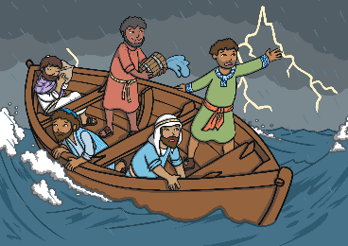
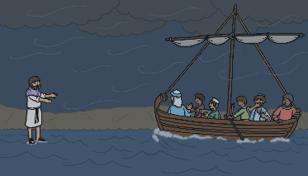
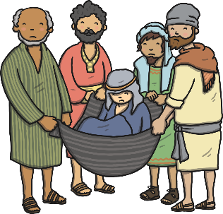
RE – Y4 – Christianity – How did Jesus change lives and why is it good news?
Finding out about Jesus through his miracles
The feeding of the 5000 One time, a huge crowd of people came to hear him speak and ask him to heal them. There were over five thousand of them and they soon became very hungry! The disciples were all at a loss as to how they could help their teacher. A disciple called Andrew said “Here is a boy with five small barley loaves and two small fish, but how far will they go among so many?” Jesus however simply gave thanks to God for the fish and the loaves and began to hand them out to the hungry crowds. He kept giving people food and never ran out. The meaning behind the miracle: The miracle shows us that Jesus cares for people’s needs. When the crowd was hungry, He didn’t send them away. Instead, He took a small amount of food and made it enough for everyone. This miracle teaches that Jesus is powerful and can provide for us, even when it seems impossible. | The calming of the storm Jesus and his disciples were crossing the Sea of Galilee when a huge storm threatened to sink the boat. Jesus just slept, while around him the disciples were terrified of drowning. “Teacher, is it nothing to you that we’re going down?” they cried out. Jesus woke up and told the wind and the wave to settle down. The wind ran out of breath and the sea was soon as smooth as glass. Amazed, they asked “Who is this, anyway?” “Wind and sea at his beck and call!” The meaning behind the miracle: This shows that Jesus has power over nature and can bring peace in the middle of frightening situations. It reminds Christians that Jesus can help them feel safe and calm, even when life is difficult. | Walking on water One day, Jesus sent his disciples in a boat to cross the lake. That night, the sea was quite rough. The disciples saw Jesus coming towards them, walking on water. They thought he was a ghost and were scared. Jesus reassured them that is was him. “It is I,” said Jesus “don't be afraid.” Peter wanted to walk on water. He stepped out of the boat and found himself walking on water too! Then, Peter saw the wind and started to feel afraid. As soon as he did, he started to sink. “Lord, save me!” Peter cried. Jesus held his hand and helped Peter out. “You of little faith,” Jesus said. “Why did you doubt?” They all climbed into the boat and the wind calmed down. All the disciples were amazed and said, “Jesus must be the son of God!” The meaning behind the miracle: This miracle shows that Jesus can do things that seem impossible. It also teaches Christians to trust in Jesus, even when things seem scary or hard to understand. | Healing the paralysed man. When people found out the Jesus could heal them, four men arrived carrying their paralyzed friend, they couldn’t get through the crowd to Jesus! “Let us through!” they cried. But the crowd would not move. They went up onto the roof and broke through the ceiling! They lowered their friend into the house through a gap. Amazed at their faith, Jesus told the man that he was forgiven for everything he’d ever done wrong. He then said to the man, “I tell you, get up, take your blanket and go home.” To everyone’s amazement, the man jumped up, completely healed! Everybody praised God and said, “We have never seen anything like this!” The meaning behind the miracle: This miracle shows that Jesus cares about both our physical and spiritual needs. It teaches Christians that Jesus can heal and bring forgiveness, and that faith in Him can change lives.

