Slide 1


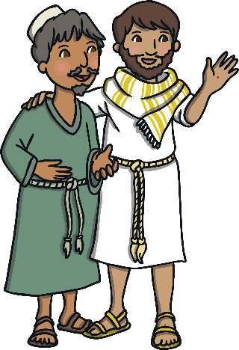
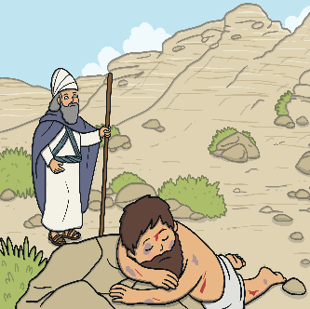
RE – Y3 – Christianity – Why did Jesus tell parables?
The Parables
Many of Jesus’ teachings were through stories called parables. A parable is a story with an underlying meaning. These stories can be found in the Gospels (four books in the Bible that tell the events in the life of Jesus). These are the books of Matthew, Mark, Luke and John and together, they are the New Testament.
Key Vocabulary
foolish | adjective. lacking good sense or judgement; unwise.
forgiveness | noun. the action or process of forgiving or being forgiven (stop feeling angry or resentful towards someone for something they have done wrong).
Gospels | noun. Matthew, Mark, Luke and John (the New Testament). Four accounts that Christians believe hold accurate accounts of the life, death and resurrection of Jesus.
love | noun. an intense feeling of deep affection.
meaning | noun. what is meant by a word, text, concept, or action.
moral | noun. a moral is a lesson that can be taken from a situation, story or parable. Many of the morals in Jesus’ parables are linked to following God’s laws.
parable | noun. a parable is a story with an underlying meaning. Jesus told many parables to teach people about God.
Prodigal Son | noun. a figure in a parable of Jesus (Luke 15:11–32); a wayward son who squanders his inheritance but returns home to find that his father forgives him.
Samaritan | noun. a Samaritan was someone from an area north of Jerusalem. noun. a charitable or helpful person
truth | noun. the quality or state of being true.
wise | adjective. having or showing experience, knowledge, and good judgement.
Why did Jesus tell parables?
Jesus told parables to teach people about God, His love and His forgiveness. Jesus understood the power of stories and used them to inspire and bring about change in his audience. Jesus taught the core values of a Christian life. For example, he taught people to love God and have faith in Him. He taught about forgiveness and how people should forgive others as God forgives them. Jesus also taught the importance of loving and treating others as you would want to be treated yourself.
The Parable of the Good Samaritan
Jesus told a story of a man walking along the road from Jerusalem to Jericho. He was attacked by robbers, who took all of his clothes and money and left him badly injured in the road. A short while later, a priest was walking along the same road. When he saw the man, he crossed the road and walked on by. Then, another man walked along the road. Again, he looked at the man lying in the road and walked on by. A Samaritan then came walking along the road. When he saw the man lying wounded in the road, he immediately stopped to help. He bandaged his injuries, gave him something to drink and put him on a donkey to take him to the nearest inn, where he looked after him until he was better. Moral: Jesus used this parable to show the importance of kindness and loving other people. The priest in this parable should have known about God’s love and shown kindness to the man in the road, but he walked on by. The Good Samaritan showed love to the man, nursing him back to health. Jesus teaches that we should show kindness and love to all people, regardless of where they come from or the situation in which they might find themselves.

Slide 2
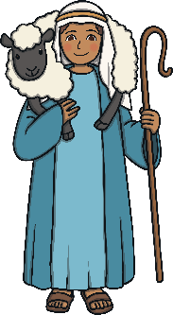
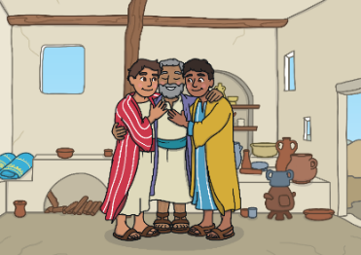
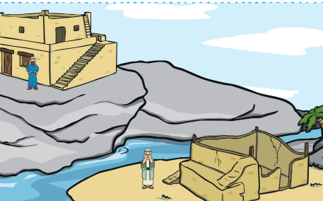
RE – Y3 – Christianity – Why did Jesus tell parables?
The Parable of the Lost Sheep
Jesus said that there was once a shepherd who had 100 sheep. At the end of the day, the shepherd noticed that only 99 sheep had returned to the herd. The shepherd left his herd and went to search for the lost sheep. He searched high and low. After a long time of searching, the shepherd found the lost sheep. He put the sheep on his shoulders and joyfully returned home. Moral: Jesus used this parable to show that God cares about each and every person and He will stop everything to care for us. The sheep in the story could also represent a lost sinner. Jesus showed that God will seek out a lost sinner and welcome them with forgiveness.
The Prodigal son
There was once a man who had two sons. One day, the youngest son asked his father for his inheritance money. The father thought about it and divided what he owned between them, giving his sons their inheritance. The youngest son moved far away and very soon spent all of his money. He was very hungry and had no place to live, so he decided to get a job. He was given a job feeding pigs but no-one gave him anything to eat. The son was very sad and very sorry for what he had done. Back home, even his father’s hired men were fed well. He decided to go back home, say sorry and ask his father for a job as a servant. When the father saw his youngest son returning, he was filled with great joy and ran to greet his returning son. He hugged and kissed the boy. The father dressed him up in the best robe, some new sandals and put a ring on his finger. The father was so happy that his son had returned that he threw a great feast to celebrate! While the younger brother had been away, the older brother had been working hard for his father and saved all of his inheritance. When he heard that his brother had returned with nothing and a great feast was being thrown for him, he felt very angry and jealous. But the father did not want his son to be jealous and angry. “We must celebrate and rejoice,” he told his older son, “because it is as if this brother of yours was dead and has come to life; he was lost and has been found.” Moral: In this parable, the father forgives his son when he returns and welcomes him home. In the same way, God waits for humans to realise what they have done wrong and ask for forgiveness and welcomes them back when they do.
The Wise Man and the Foolish Man
Once there were two men who decided to build themselves houses. The foolish man built his house on the sand. When the rains came and the land flooded and the house collapsed. But the wise man built his house on the rock. When the rains came and the land flooded, his house remained standing! Moral: When a person builds his life on Jesus' words, he is building a strong foundation. He will be strong inside. The foolish man in the parable was like someone who listened to Jesus' instructions but then did not follow them. A person who does not build his life on Jesus' words will not have a strong foundation.
Stories
The Parables were stories with lots of special lessons for Christians. Stories may not always have hidden meanings. What is your favourite story? Does it have any special meanings or messages for the reader?

