Slide 1

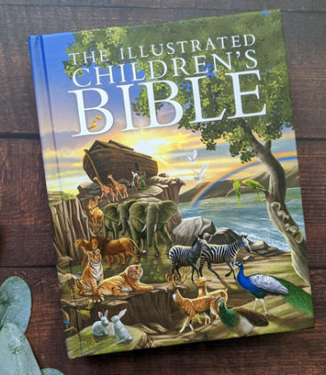
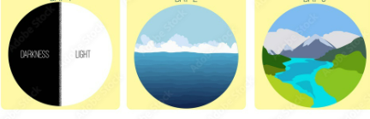
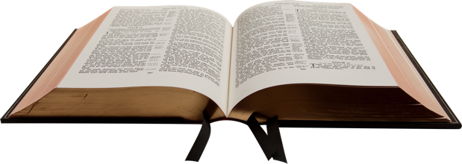
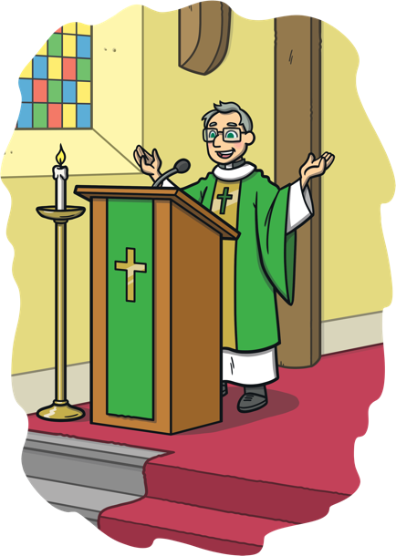
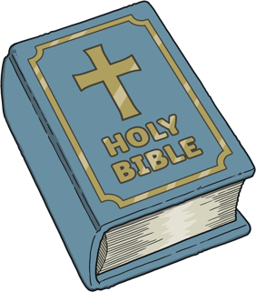
RE – Year 2 – Christianity – Why is the Bible an important book for Christians?
What is the Bible?
The Bible is the holy book of Christianity. The Bible was written long ago by many different authors and includes books of history, songs, poetry, letters, prayers plus much more! The Bible contains lots of stories about God and people. Some of them you might have heard of, such as the story of creation. The Bible also contains rules and guidance that Christians try to live by.
The Creation Story
In the Bible, Christians learn about how the world was created by God. On day 1: God created light by saying, “Let there be light!” On day 2: God created the sky and sea. On day 3: God created land, trees, and plants. On day 4: God created the sun, moon and stars. On day 5: God created the birds and sea animals. On day 6: God created animals and Adam and Eve. On day 7: God rested.
Key Vocabulary
altar | noun. An altar is a raised area in a house of worship where people can honor God with offerings.
Bible | noun. Holy book of Christianity which is made up of the Old Testament and the New Testament.
book | noun. a written or printed work consisting of pages glued or sewn together along one side and bound in covers.
creation | noun. The making of something, such as the universe.
God | noun. the creator and ruler of the universe.
image | noun. a picture or some other likeness of a person or thing.
lectern | noun. a tall stand with a sloping top to hold a book or notes from which someone can read while standing up.
narrative | noun. a spoken or written account of connected events; a story.
story | noun. an account of something that happened, either true or made up.
How is the Bible organised?
The Bible is split into two main parts, the Old Testament and the New Testament. The Old Testament tells the story of the Jewish people. Most of the Old Testament is also part of the Jewish Holy Book, the Tanakh. The New Testament is about Jesus and the first Christians. Each part is separated into sections called books. The Old Testament is the first part of the Bible and it is made up of 39 books. The New Testament is the second part and is made up of 27 books which makes 66 in total! Each book is split into chapters and each chapter is then split into smaller sections called verses which makes it easier to find certain bits – the Bible is a very long book! For example, a section of the Bible might be written like this: John 3:16. This means John chapter three, verse 16. This makes it easier for people to find certain parts of the Bible.
How is the Bible read?
In lots of churches, the Bible is kept at the front of the church on a special table called the altar. The leader of the church, sometimes called a priest, vicar or minister, might stand behind a lectern and read from the Bible. In some churches, there is a calendar that explains which part of the Bible should be read on each Sunday. Many Christians have their own Bibles that they read themselves at home.
What Different Versions of the Bible Are There?
Some versions of the Bible use traditional language from a long time ago, while others use more modern language. There are children’s Bibles with brightly coloured pictures. Different types of churches have different types of Bibles.

Slide 2
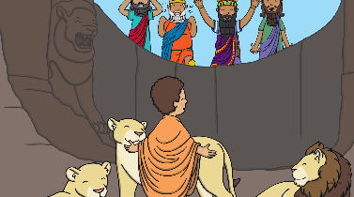
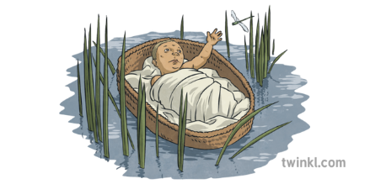
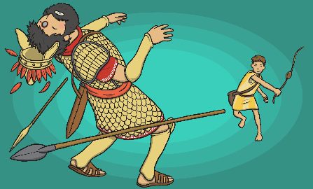
RE – Year 2 – Christianity – Why is the Bible an important book for Christians?
The story of Joseph
Joseph’s brothers were jealous of him because their father, Jacob, loved him most. His brothers made a plan to sell him as a slave, and Joseph ended up in Egypt. Even though life was tough, Joseph trusted God. He became a powerful leader in Egypt because he could interpret (understand and explain the meaning of) dreams which helped save the country. When his brothers came to Egypt for food, Joseph forgave them, showing kindness instead of revenge. In the end, Joseph’s family reunited, and his story shows how forgiveness and faith can bring good from bad situations.
The Story of Daniel and the lion’s den
A long time ago, there was a man named Daniel who loved God very much. He lived in a place ruled by King Darius. Daniel prayed to God every day because he trusted Him. Daniel was so wise and good that the king liked him a lot. But some other men were jealous of Daniel and wanted to get him in trouble. So, they made a new law that said no one was allowed to pray to anyone but the king for 30 days. But Daniel kept praying to God, just like always. The men saw Daniel praying and told the king. The king was sad because he liked Daniel, but he had to follow the law. Daniel was thrown into a den full of hungry lions! But guess what? God sent an angel to shut the lions' mouths, and they didn’t hurt Daniel at all! The next morning, the king ran to the den and called out, "Daniel, are you okay?" Daniel answered, "Yes! God kept me safe.“ The king was so happy! He had Daniel taken out of the lion's den and made a new law that everyone should respect Daniel's God because He was the true God who saved Daniel.
The Story of Moses
A long time ago, in a land called Egypt, the king (called Pharaoh) was very mean to the Israelites, who were God's people. The Pharaoh made them work very hard as slaves. One day, a mother had a baby boy named Moses. Pharaoh didn't want any baby boys to grow up, so the mother put Moses in a basket and hid him in a river. Pharaoh's daughter found the basket and decided to take care of Moses. He grew up in the palace like a prince! When Moses was older, he saw how badly his people were being treated, and it made him sad. God spoke to Moses through a burning bush and told him to help free the Israelites from Pharaoh. Moses was scared but trusted God. Moses went to Pharaoh and said, "Let my people go!" but Pharaoh said no. God sent 10 plagues to Egypt, like frogs and darkness, to show Pharaoh that he was serious. Finally, Pharaoh agreed, and Moses led the Israelites out of Egypt. But Pharaoh changed his mind and chased after them. Moses stretched out his staff, and God parted the Red Sea so the Israelites could walk through on dry land! They were free, and Moses led them to a special place called the Promised Land. On their journey, Moses went up a mountain called Mount Sinai, and God gave him the Ten Commandments. These were special rules to help people live good lives and love God and each other. Moses shared these rules with the Israelites so they could follow God's ways. God took care of His people, and Moses trusted Him.
The Story of David and Goliath
A long time ago, there was a young boy named David. He was a shepherd, which means he took care of sheep. David loved God and trusted Him with all his heart. One day, a big giant named Goliath was making fun of God’s people, the Israelites. Everyone was afraid of Goliath because he was so big and strong. He said he wanted to fight someone, but no one was brave enough. David went to visit his brothers, who were soldiers, and heard Goliath. Even though David was just a boy, he trusted God and knew that God would help him. He told the king he would fight Goliath. The king was worried, but David said, “God helped me protect my sheep from lions and bears, and He will help me fight Goliath too!” So, David went to fight the giant with just a sling and some small stones. Goliath laughed when he saw David, but David wasn’t afraid. He took a stone, put it in his sling, and threw it at Goliath. The stone hit Goliath right in the forehead, and the giant fell down! David won because God helped him. David became a hero, and later, he became the king of Israel. He always trusted God, and God blessed him.

