Slide 1

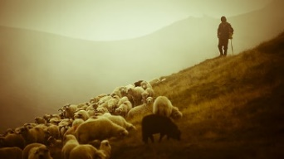
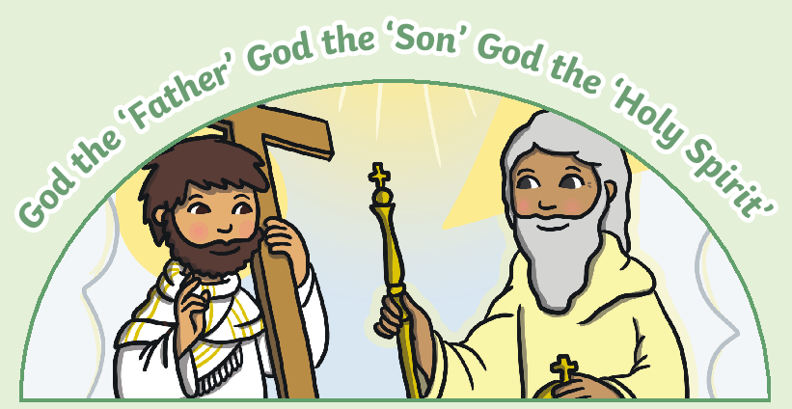
Year 1 – RE – Christianity – What is God like for Christians?
God in Christianity
Christians believe that God is the creator of the universe, including the heavens and the Earth. They believe that God is all-powerful and forgiving. He sent Jesus Christ, His son, to Earth. Jesus died so humans could be forgiven.
Key Vocabulary
adjective | noun. a word that describes a noun.
belief | noun. something that someone thinks is true.
Bible | noun. a holy book for Christians.
Christian | noun. a person who follows the teachings of Jesus Christ.
creator | noun. someone or something that makes or creates things.
describe | verb. to say what something or someone is like.
God | noun. the supreme being in many religions that people pray to.
image | noun. a picture or idea of what something looks like.
king | noun. a shape, design or idea that is used to represent something.
Kingdom | noun. a place ruled by a king or queen.
God’s many characteristics:
Christian beliefs about God are connected with words and images from the Bible (Creator, Shepherd, Father, King). Christians use different words and images to describe God: He is called the Creator because the believe he made everything. He is called a Shepherd because, like a shepherd takes care of his sheep, Christians believe God watches over and cares for people. He is called a Father because Christians think of God as a loving parent. He is called a King because they believe God rules over the world with wisdom and love. God is often described by Christians as being like a light in the darkness. This image is a metaphor that means God is a support for people during hard times and that He is completely good.
Describing people around you:
Think about some of the people in your life—your family, friends, or teachers. Each person is special in their own way. Maybe your grown ups are kind, your friend is funny, and your teacher is helpful. Christians believe that God is special in many ways too—He is kind, loving, and always there to listen.
Ideas about God:
Everyone has different ideas about what God is like. Some people think of God as very powerful, while others see Him as gentle and loving. It’s important to listen to other people’s ideas and share your own thoughts. What do you imagine God might be like?
Christians believe God loves them and all people.
Christians believe that God loves everyone, no matter where they live or what they look like. They believe that God’s love is big enough for everyone in the world, just like the sun shines on everyone equally. Christians believe that God is always there to help them, like a parent or friend. They think that God is both powerful and gentle, like someone who can create the world but also cares deeply about each person.
The Holy Trinity
‘Tri’ means ‘three’ This describes the idea that God exists as three parts in one.
How do Christians learn more about God?
To learn more about God, Christians might look at the Bible, paintings, or songs. These can all give clues about what Christians believe God is like. For example, in the Bible, there are stories about God helping people and showing kindness.

