Slide 1



Welcome

Slide 2
Aims
To explain the Langshott approach to end KS2 SATs.
To give an update on the residential.
To provide an overview of ‘Life after SATs’.
To communicate transition information.

Slide 3


Slide 4
Preparation
-They have been working SO hard at school!
-Please see the letter sent home before Easter about how you can support your child with revision at home (CGP guides, question books, past papers).
-All children sit the same tests (no higher/lower options).
-Weekend before – relax!
Sleep – so important!
Clubs – they may be too tired that week!
Celebrate hard work and effort.

Slide 5
Preparation
-Optional SATs Breakfast at 8am Mon – Thurs.
Free to everyone.
Continental style.
Mindfulness/relaxing experiences.
Opportunities for movement.
Siblings are not invited/there is no provision for them at school during this time.

Slide 6
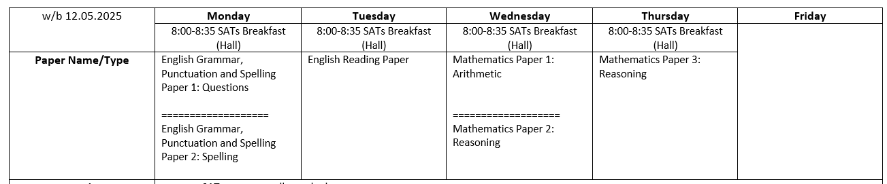
SATs week
Monday 12th – Thursday 15th May
SATs (Standardised Assessment Tests). Everyone in the country sits them at the same time!
All marked externally.

Slide 7
Arrangements
PLAIN water bottle (no measurements, non-noisy, easy to open)
Individual tables
Resources available (2 pencils, ruler, protractor, mirror)
Reading questions
Spread out across different rooms
Specific individual circumstances – we know your children well and we have planned to meet their needs (access arrangements).

Slide 8
SATs week – the important details!
Wellbeing is important this week.
PE kit can be worn all week.
The tests only take up a small part of the day (apart from Wed).
Please send extra fruit for break time snack.

Slide 9
SATs results
WTS (working towards the standard)
EXS (working at the expected standard – met)
GDS (working at greater depth within the expected standard – still ‘classed’ as met).
WTS, EXS and GDS raw scores – matched to scaled scores.
Threshold scores change every year (depending on the ‘difficulty’ of the test).
Results in July – shared with the summer term report.

Slide 10
Teacher Assessment
Writing:
Children are building a portfolio of writing in class.
Used to assess their writing skills.
-working towards the expected standard (WTS).
-working at the expected standard (EXS).
-working at greater depth within the expected standard (GDS).
Writing may be externally moderated.

Slide 11
Teacher Assessment
Science:
-working at the expected standard (met).
-working towards the expected standard (has not met).
Not based on tests.

Slide 12
Setting at Secondary School
Secondary Schools receive SATs scores.
Secondary Schools conduct their own testing procedures at the start of Year 7.
There is a lot of collaboration between us and Secondary schools but they make the final decisions.

Slide 13
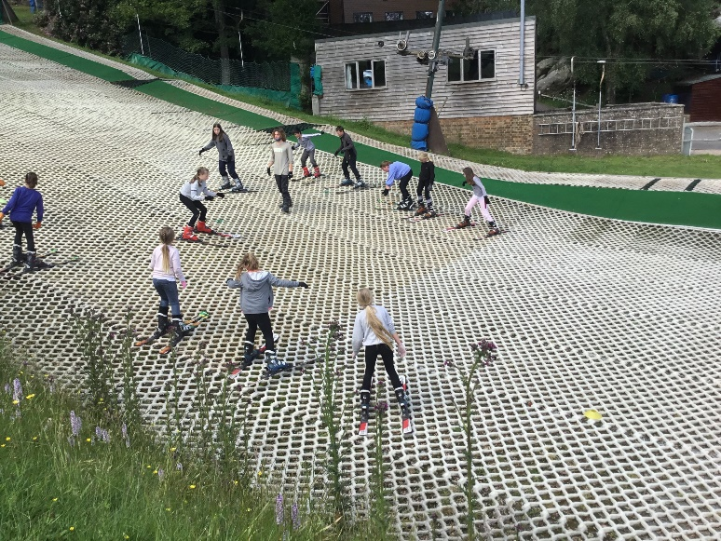
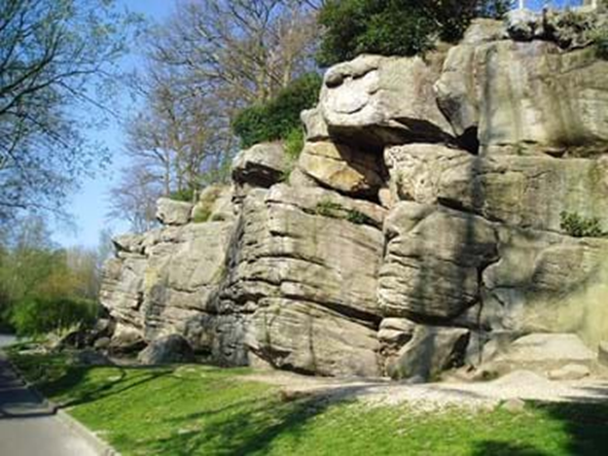
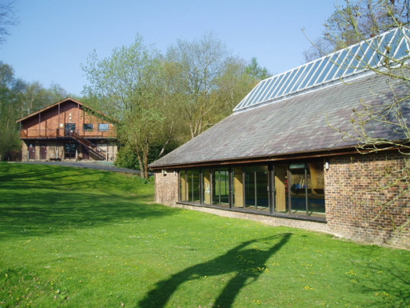
Residential
16th – 18th June 2025

Slide 14
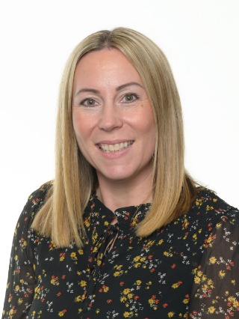
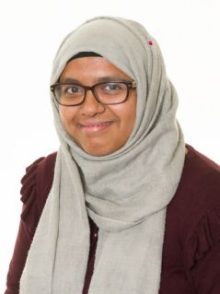
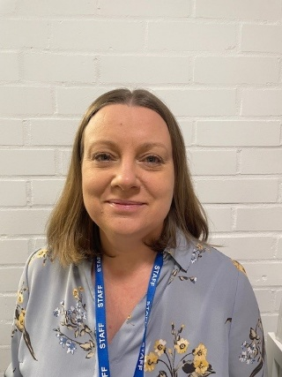
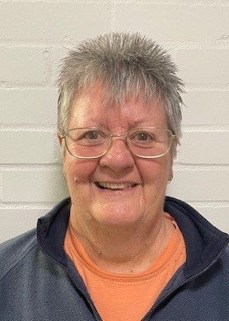
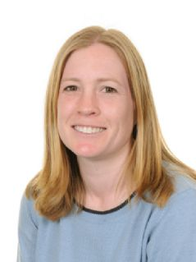
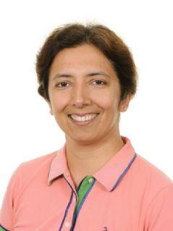
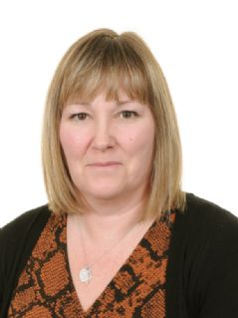
Langshott adults
Mrs Shevel Miss Miah Mrs Pannell Mrs Groves
Mrs Dawes Mrs Nagpal Mrs Forster

Slide 15
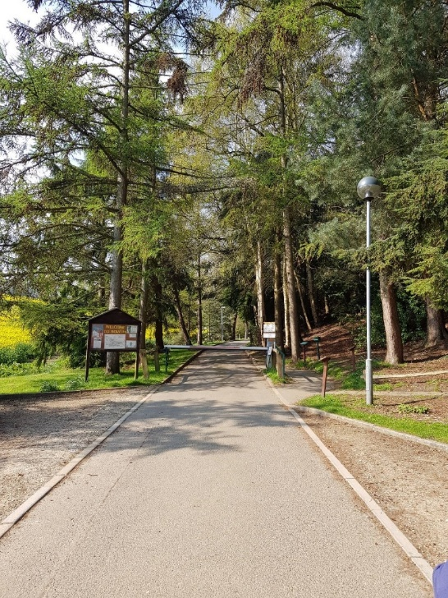
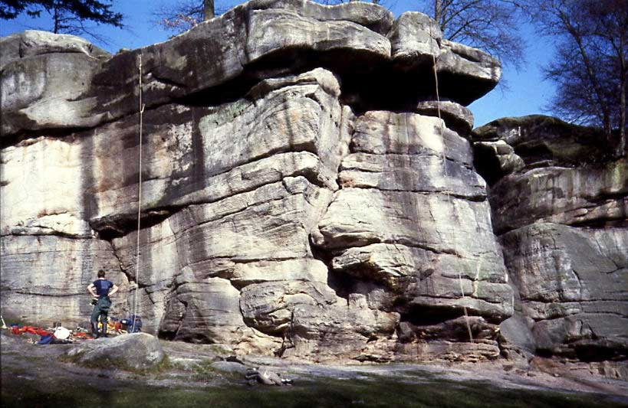
Bowles, Crowborough
4 private hectares along the length of a natural sandstone cliff, deep in the Sussex countryside.

Slide 16
Residential
Final letter and timetable will be issued nearer the time.
Travelling by coach from the top of the drive.
Drop off at school hall between 09:00-09:15 (ready to leave at 09:45).
Back at school on the Wednesday around 17:30 (leaving Bowles at 16:30).

Slide 17
Medical form
Take your forms this evening – return by 7th May.
This is our ‘bible’ for looking after your child.
Please include all relevant information.
Remember travel sickness tablets if needed - and one for the return journey.
Hand (prescribed) medicines to Mrs Forster.

Slide 18
Kit list
Take your kit list this evening.
Luggage – Children must be able to carry/wheel it.
Name all belongings.
No technology or electricals (apart from digital cameras).
£10 spending money (maximum).
They are allowed to bring savoury snacks.

Slide 19
Residential
You will all be informed when we arrive.
(No other updates planned).
Children do not have contact with their families during the trip.
We promise to phone home if needed.
Children are with school staff at ALL times.
Groups (activities and rooms).
The children find out their dorm/day groups when they arrive.

Slide 20
Residential
Three full days of activities run by an incredibly experienced and dedicated team of staff.
Bowles run 3 activity sessions each day, with the last activity finishing at 9.15pm. This full day ensures that the children gain the maximum from their visit – and they sleep well!

Slide 21
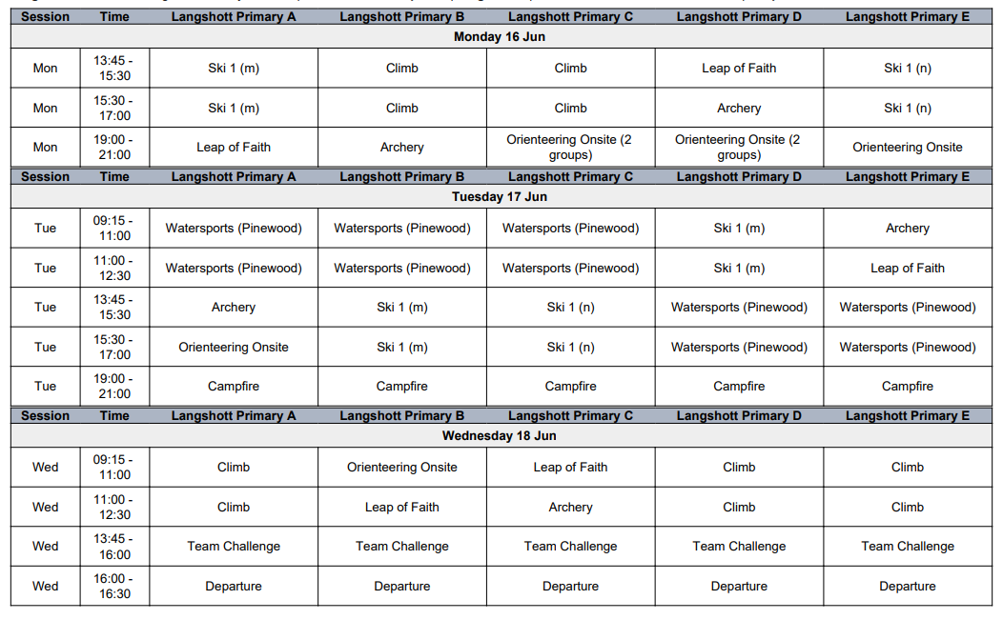
Example itinerary

Slide 22
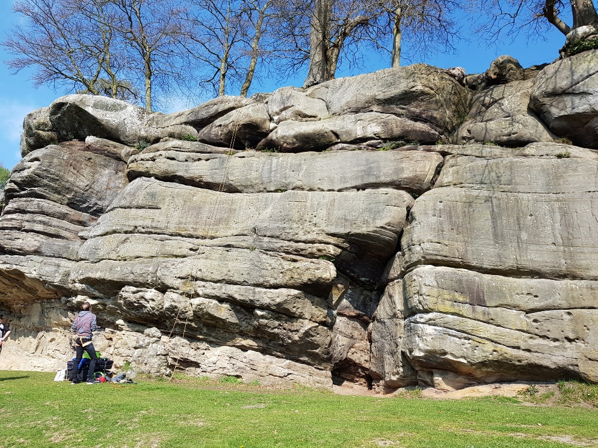
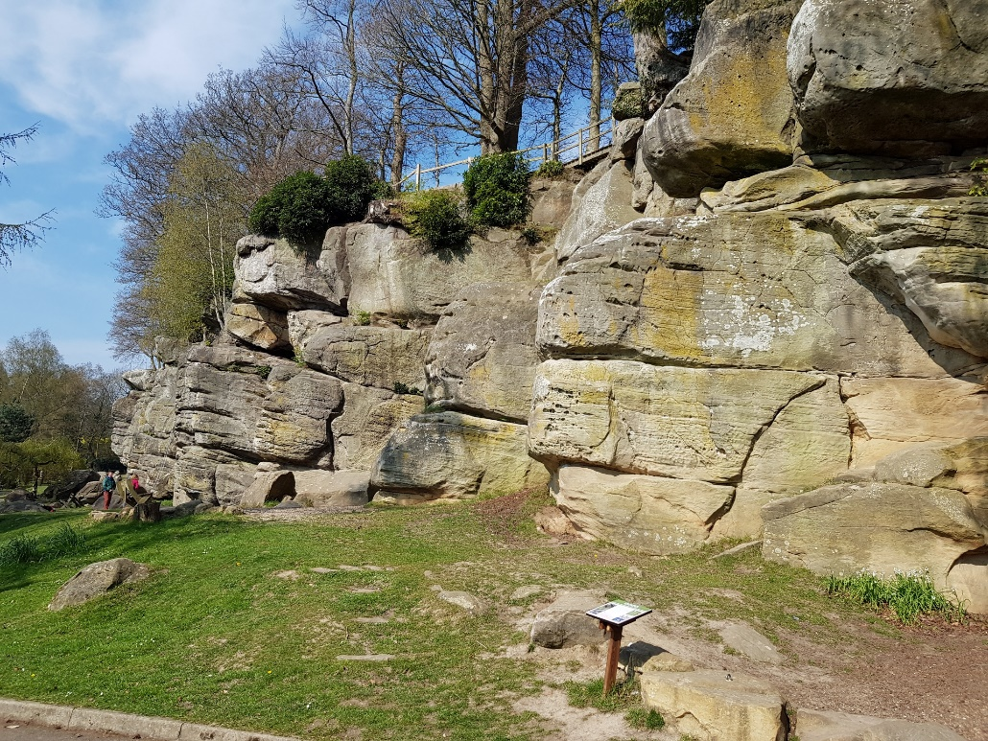
Rock climbing

Slide 23
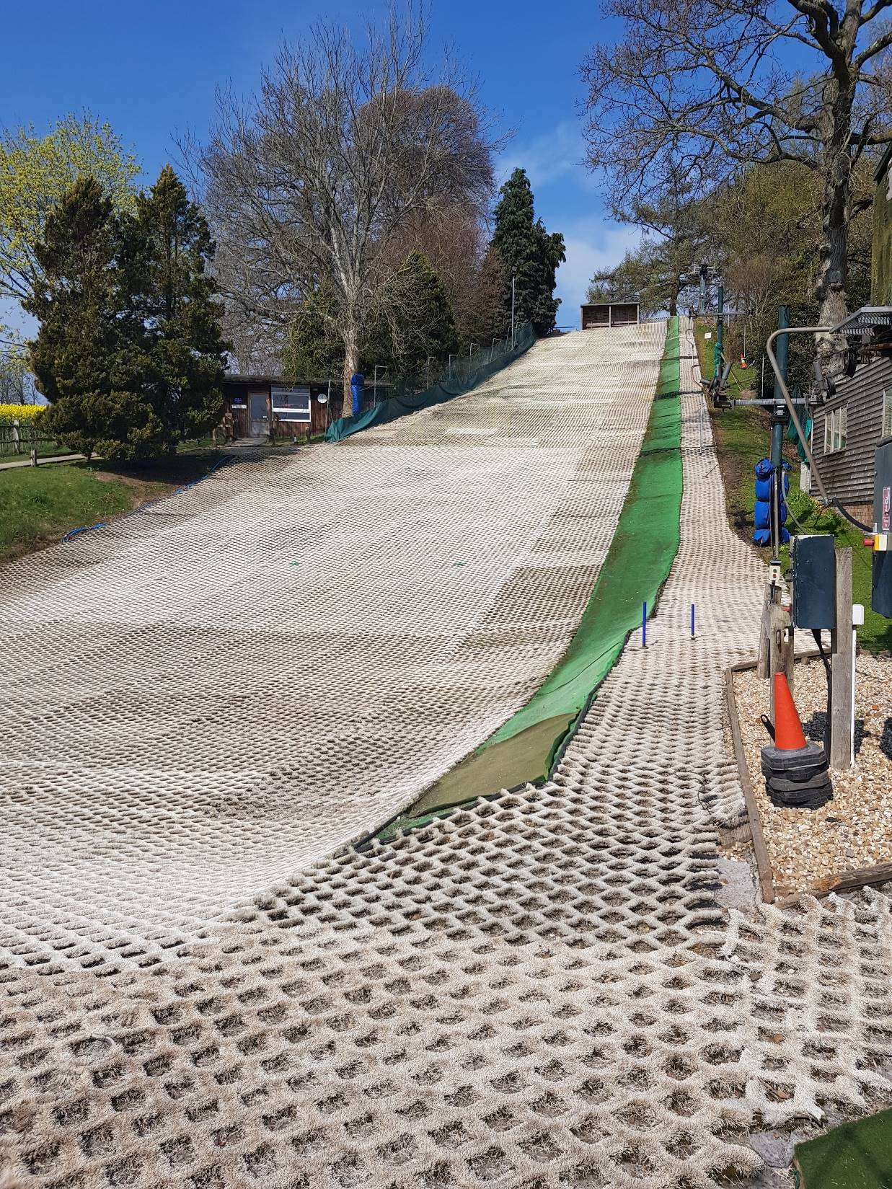
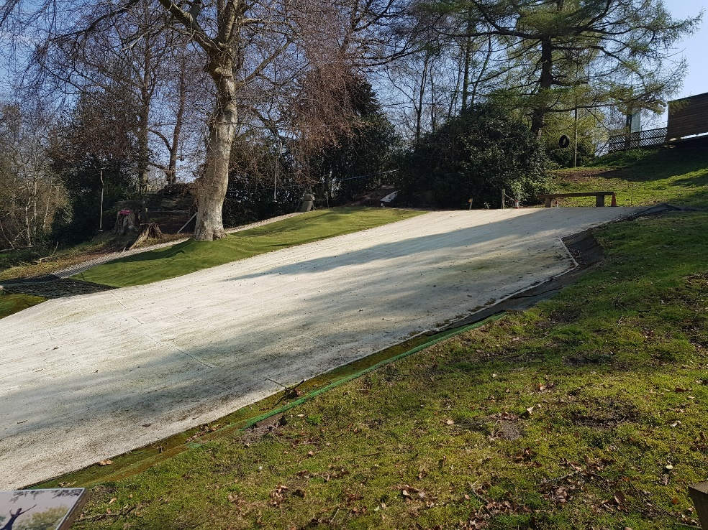
Skiing

Slide 24
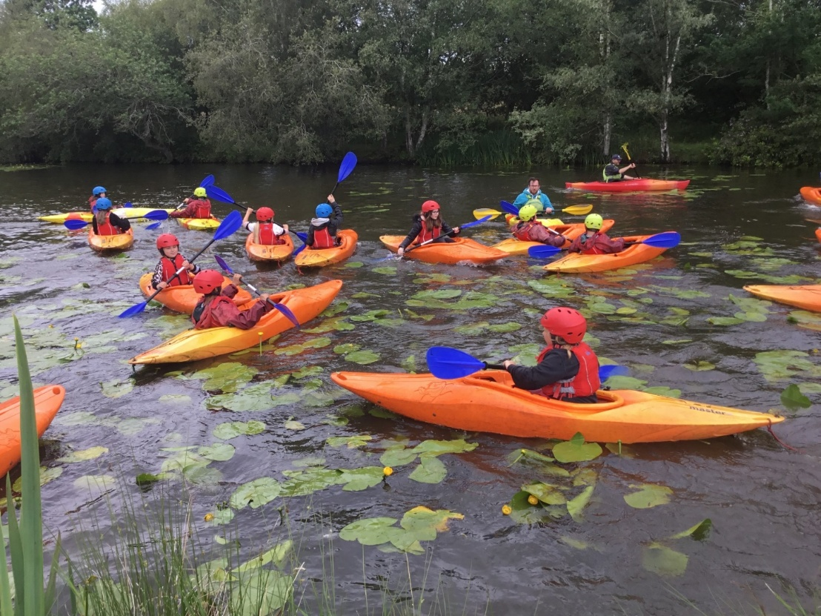
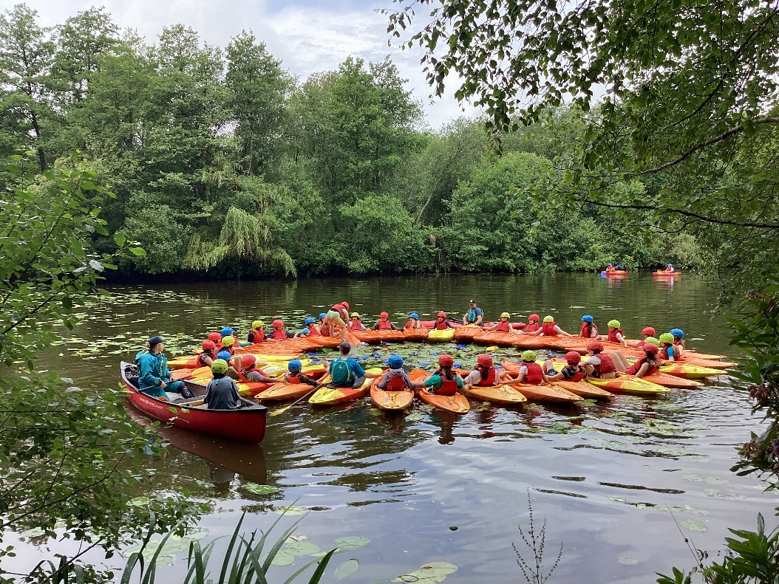
Water Sports

Slide 25

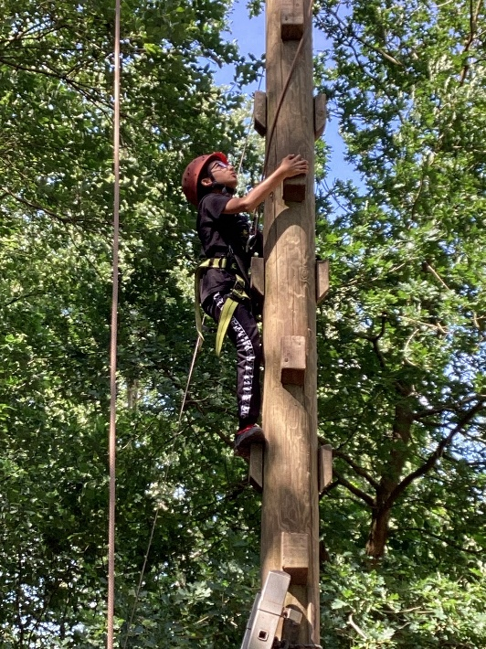
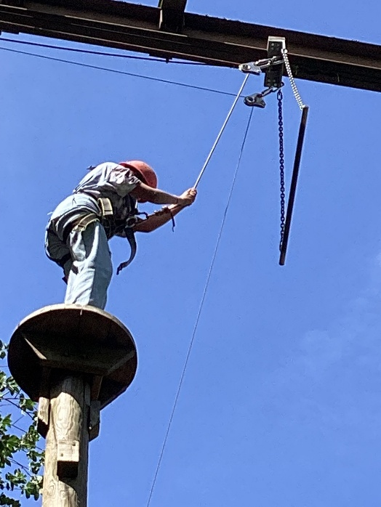
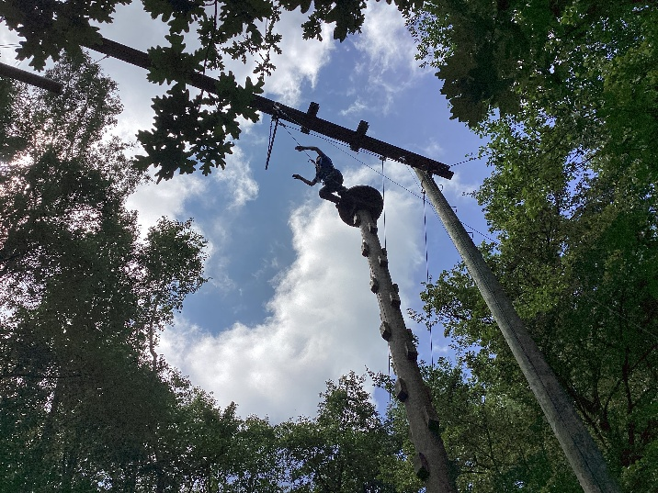
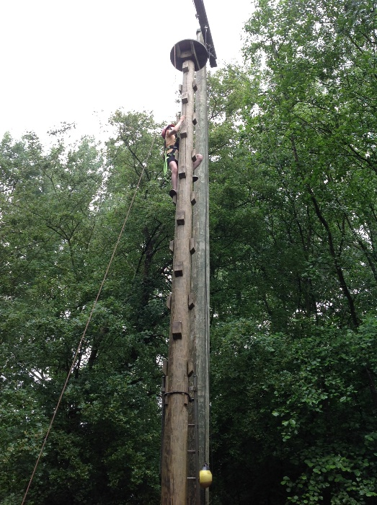
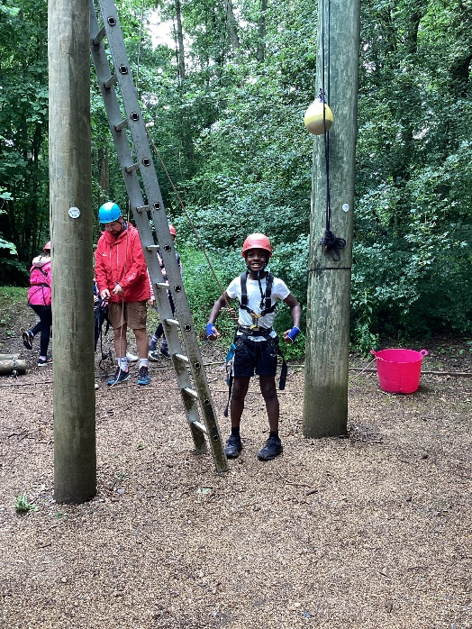
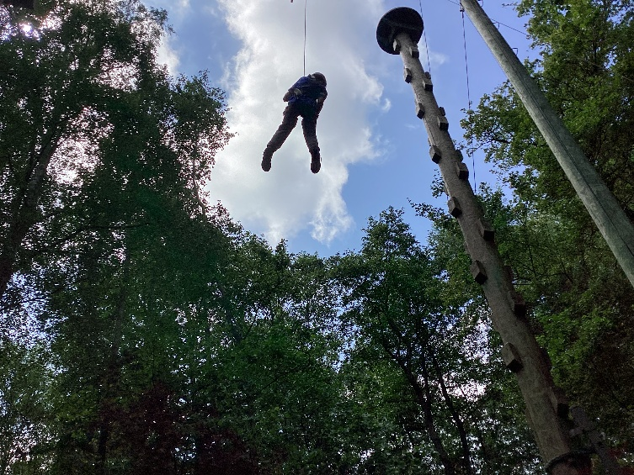
Leap of Faith

Slide 26
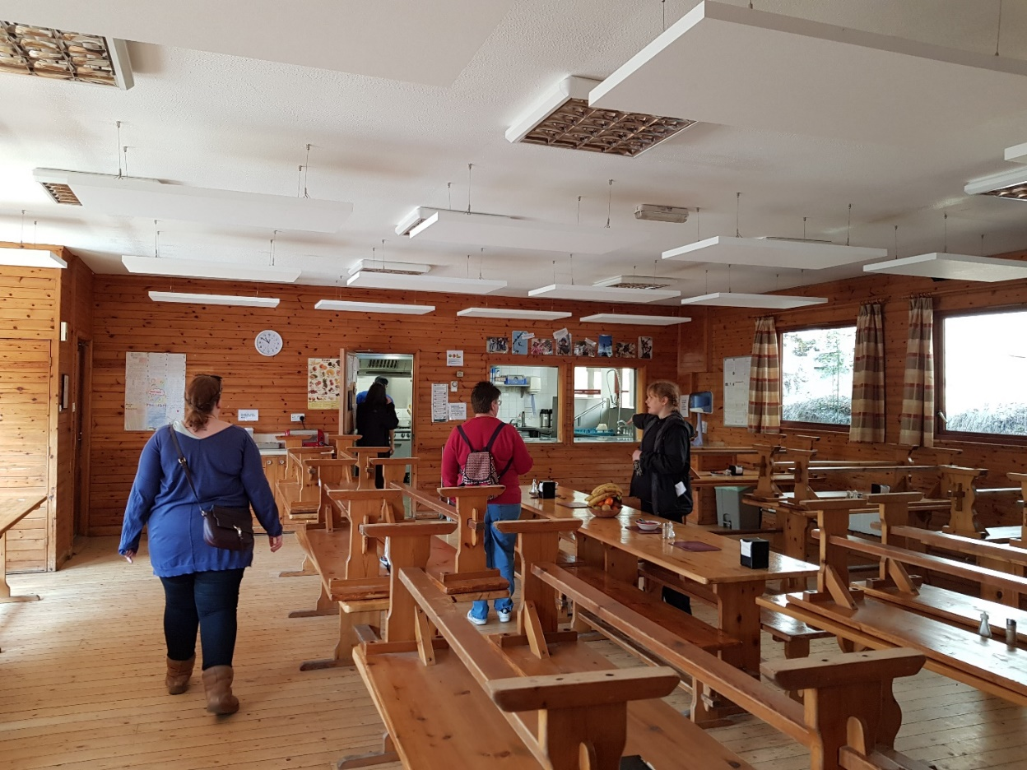
Food!
Children will have lovely, fresh meals each day.
Monday – Lunch and dinner
Tuesday – 3 meals
Wednesday – Breakfast and lunch.
Allergies will be catered for – please include information on medical form as needed.

Slide 27
Evening routines
Activities:
Night walk – around the local area.
Camp fire – songs and food
Treasure hunt – around the camp/woods
Team challenge – team building games.
Staff rooms are labelled.
Staff will stay outside until late.
Children will know their closest adult room and that they can knock at any time.
We will check in with all rooms before bed time.

Slide 28
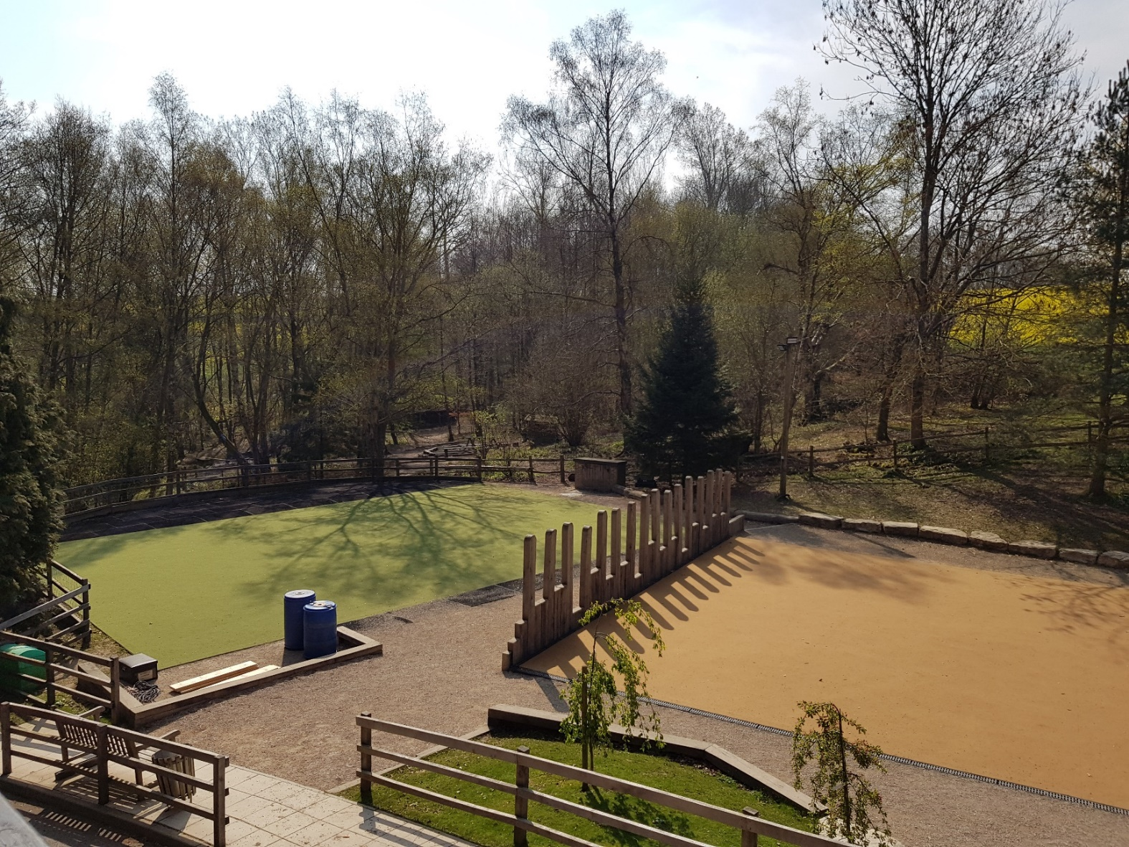
Down time (free time)
Own designated area for our children

Slide 29
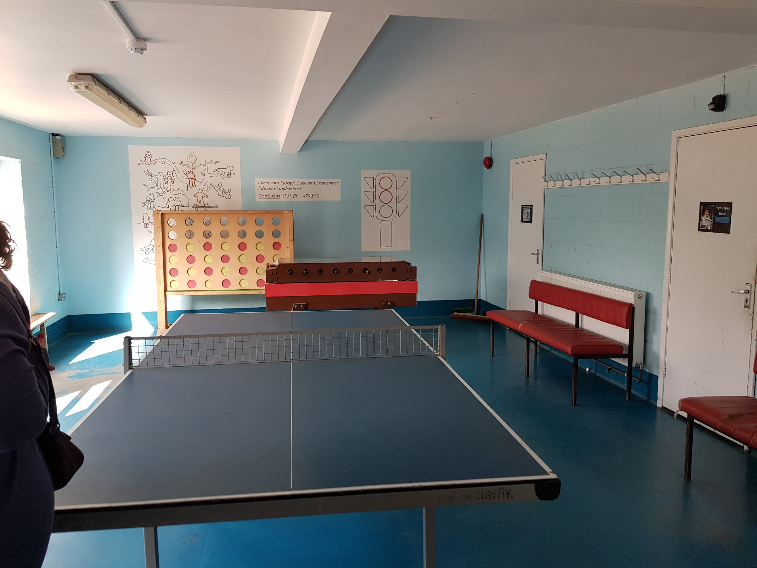

Slide 30

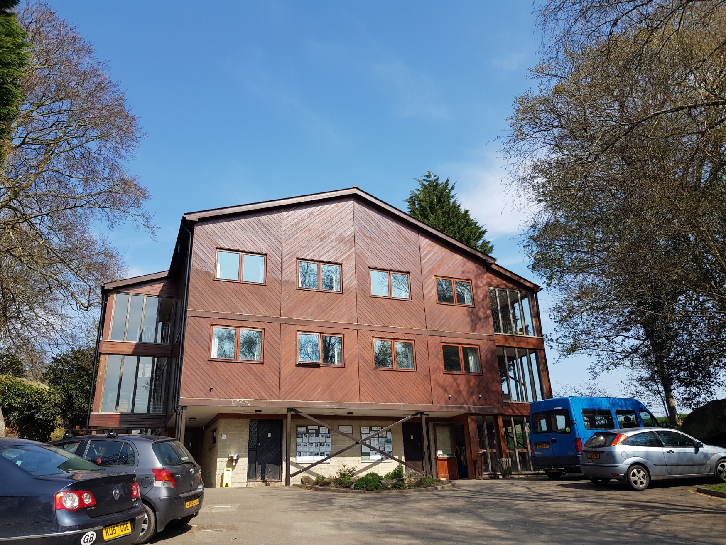
Accommodation

Slide 31
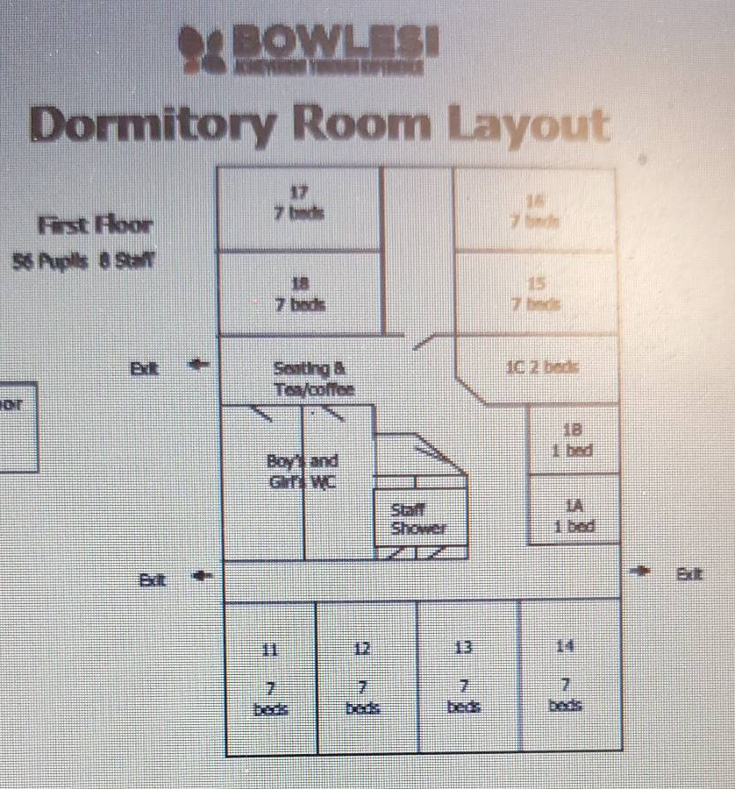
We will have 1 floor of the chalet.

Slide 32
Behaviour
No children to go in other bedrooms.
Listen carefully to every adult’s instruction for your own safety.
No leaving the group without permission.
After lights out, go to sleep.
Quiet, courteous behaviour in the dinner hall.
Failure to comply could mean parents being called to pick up children.

Slide 33



Thursday 19th and Friday 20th
Timings - normal
Thursday - Graffiti artist workshop and normal school lunch/packed lunch.
Friday - large inflatables on the playground and pizza and ice cream provided for lunch

Slide 34
Life after SATs
Lessons, learning and routine will continue (after the residential).
Broad and balanced curriculum.
We will be putting on a production and a leavers’ assembly!
Working towards the Year Book! (If you have any old class photos, please send them in!)

Slide 35
Final celebrations
9th July – Year 6 show (morning and afternoon performances). Tickets (2)
21st July – Leavers’ assembly. Tickets (2)
21st July – Leavers’ disco (evening).
22nd July – last day (t-shirt signing etc).

Slide 36
Transition
We will be working closely with all secondary schools.
PSHE lessons will focus on transition.
Transition day.
Secondary schools make their own decisions about setting children.
Parent support for transition.

Slide 37
Transition – skills
Greater focus on non-fiction in KS3 and beyond.
Still read to your child.
Work on continuing to develop reading stamina.
“We are defined by our ability to read fluently.”
Teach them to tie a school tie if needed.
Try out carrying a heavy bag!
Independence to manage a timetable and homework.

Slide 38
Another thank you
Thank you for your support.
Well done to your wonderful children.
Lots to look forward to!
All finer details and exact timings will be confirmed nearer the time.

