Slide 1



Welcome

Slide 2
What is the Phonics Screening Check?
Year 1 children will be taking the phonics screening check in June.
The phonics screening check is designed to confirm whether individual children have learnt phonic decoding and blending skills to an appropriate standard.

Slide 3
What will children be expected to do?
The check is very similar to tasks the children already complete during phonics lessons.
Children will be asked to ‘sound out’ a word and blend the sounds together.
The focus of the check is to see which sounds the children know and therefore the children will be asked to read made up ‘nonsense’ or ‘alien’ words.
chime

Slide 4
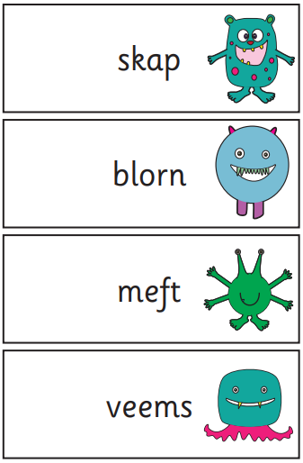
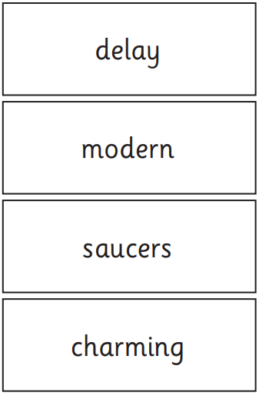
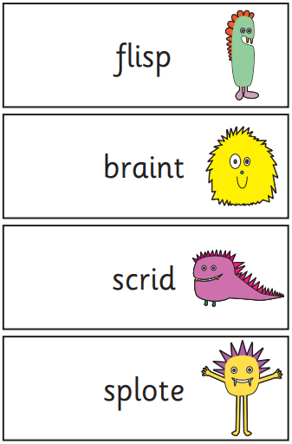
Examples
Notes:
What happens during the screening?
The test contains 40 words. Each child will sit one to-one and read each word aloud to a teacher. The test will take approximately 10 minutes per child, although all children are different and will complete the check at their own pace. The list of words the children read is a combination of 20 real words and 20 pseudo words (nonsense words).
Pseudo words SOODOUGH
The pseudo words will be shown to your child with a picture of an alien. This tells the children that this word will not make sense to them. Pseudo words are included because they will be new to all pupils; they do not favour children with a good vocabulary knowledge or visual memory of words.
The words gradually get more difficult. The phonics screening check covers phases 2 to 5. This inludes alternative pronunciations such as ch in chef.

Slide 5
Arrangements
The check will be administrated during the week of the 10th June. Your child will not have a designated time slot but we will ensure that the check is carried out in the morning session.

Slide 6


Preparation
As always, ensure that you read as much as possible to and with your child. Other ways to support your child with reading are to:
Play lots of sound and listening games with your child.
Encourage and praise – get them to have a ‘good go’.
If your child is struggling to decode a word, encourage them to draw the sound buttons underneath then say each sound in the word from left to right. Then blend the sounds by pointing to each one.
Discuss the meaning of real words if your child does not know what they have read.
Model a love of reading and enjoyment of stories!
Ask questions about the books they are reading.
Re-read words and sentences to improve fluency and ensure they understand what they are reading.

Slide 7
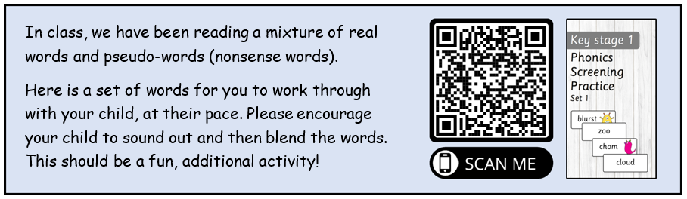
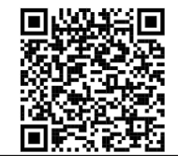
Preparation
In your child’s reading diary last week, you should hopefully have noticed the attached sticker. On a phone or iPad, open the camera and scan the following bar code. This will then take you to a webpage with pre-generated practice words, presented in the style of the check. We have more of these stickers to go out prior to half term!

Slide 8
Reporting to Parents
Results from the check will be used to analyse our own performance. It also helps us to assess the support and current provision in place for the children.
At the end of the summer term you will receive your child’s school report and confirmation of your child’s score. We will also confirm if the child has met the standard threshold.
Children who do not achieve the expected level will have support put in place and retake the test when they are in Year 2.

Slide 9

Questions
If you have any questions, please email Miss Pull at info@Langshott.surrey.sch.uk

